Slide 1
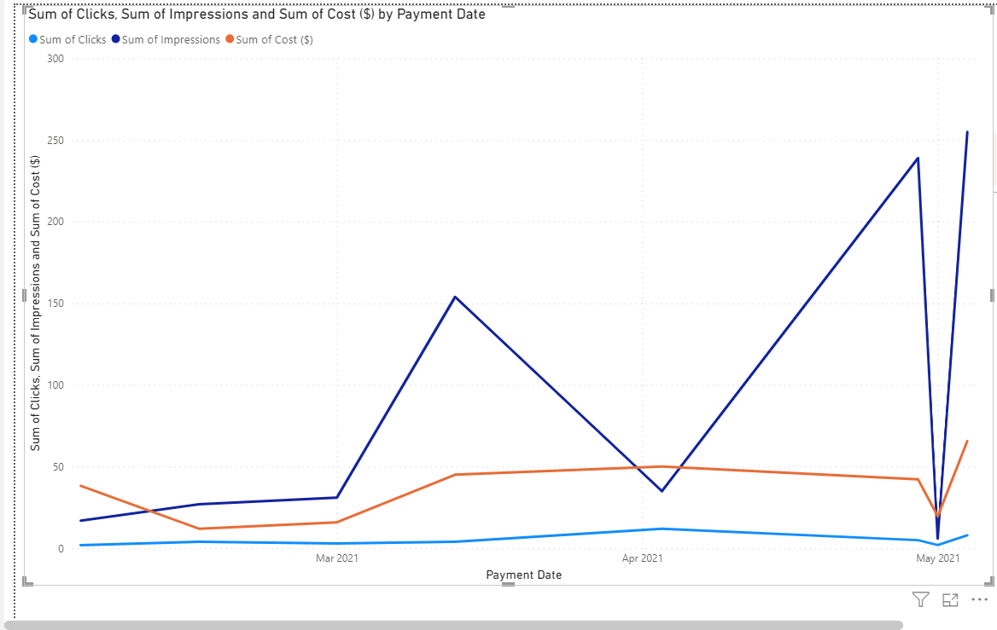
Line Chart to analyse impression,clicks and cost over time

Slide 2
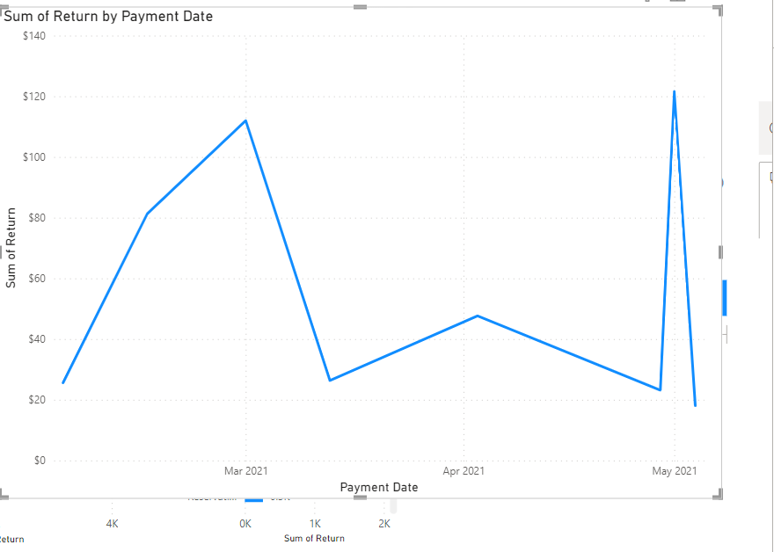
Line Chart to analyse return over time

Slide 3
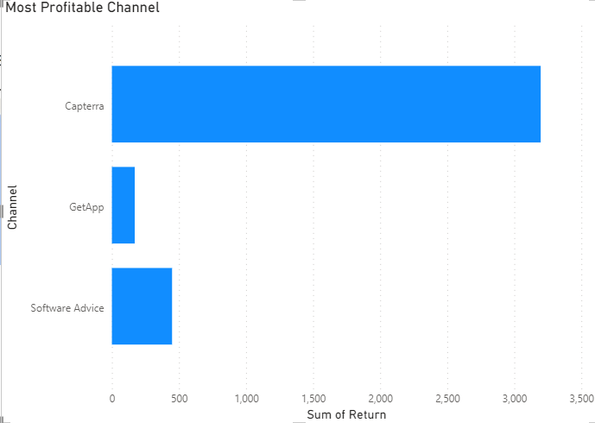
Most Profitable Channel

Slide 4
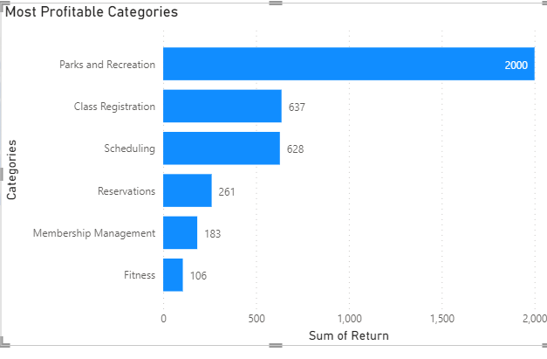
Most Profitable Category

Slide 5
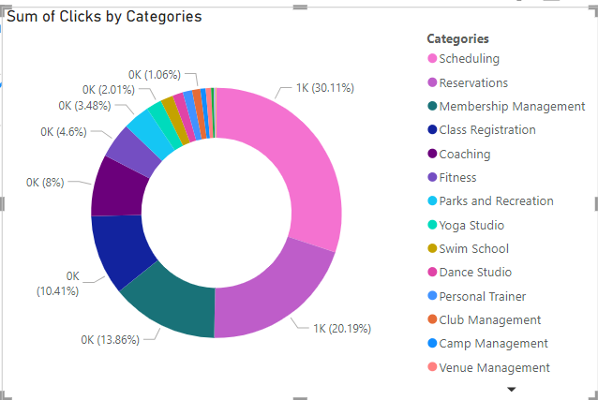
Donut Chart for Proportions: Used a donut chart to showcase the proportions of different categories keywordsour dataset.

Slide 6
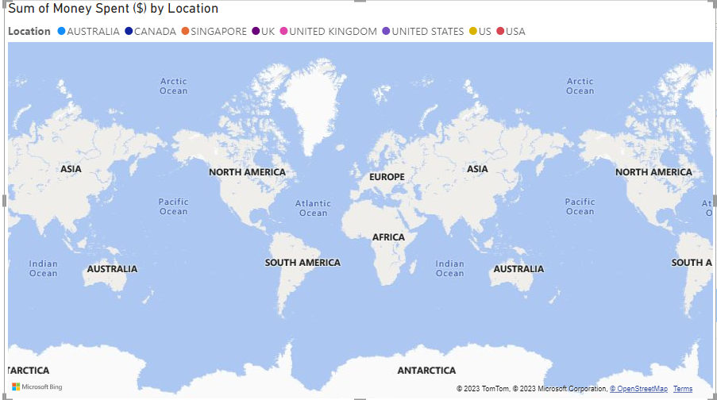
Geographic Map Chart to show money spent across various location

Slide 7
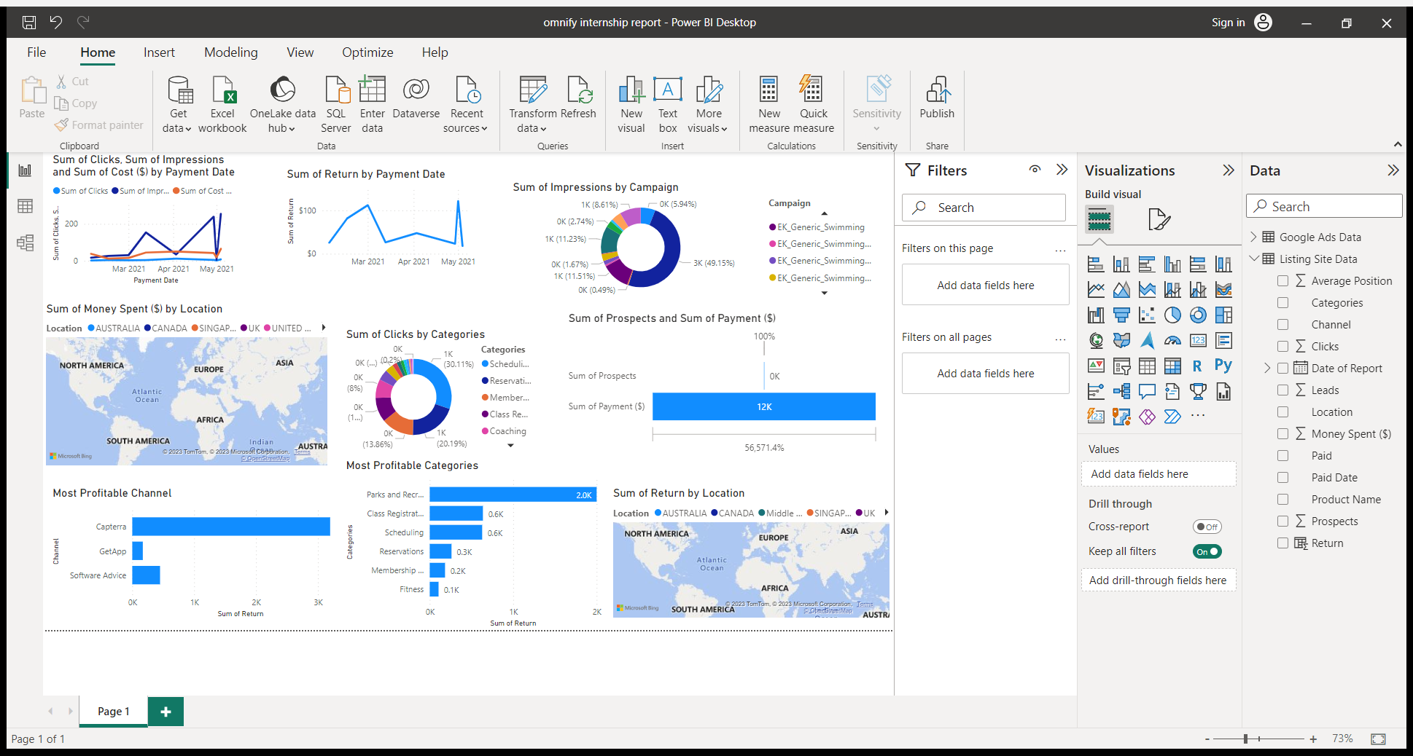
Geographic Map Chart to show return percent across various location

Slide 8
The Entire report made in power bi

Slide 9
THANK YOU

